Slide 1
Term project Tutorial for Using SimpleScalar
CA, 2017 Fall
Sang Jun Nam, TA
heesosic@korea.ac.kr

Slide 2
Simulator
What is an architectural simulator
A tool that reproduces the behavior of a computing device
Why use a simulator
A faster, more flexible software development cycle
Permit more design space exploration
Facilitates validation before H/W becomes available
Level of abstraction is tailored by design task
Possible to increase/improve system instrumentation
Usually less expensive than building a real system
We use the SimpleScalar (uni-processor, superscalar)
Widely used in the academia and industry

Slide 3
SimpleScalar
Sim-Fast
Sim-Safe
Sim-Profile
Sim-Cache
Sim-BPred
Sim-Outorder
300 lines
functional
No timing
350 lines
functional w/checks
900 lines
functional
Lot of stats
< 1000 lines
functional
Cache stats
Branch stats
3900 lines
performance
OoO issue
Branch pred.
Mis-spec.
ALUs
Cache
TLB
200+ KIPS
Performance
Detail

Slide 4
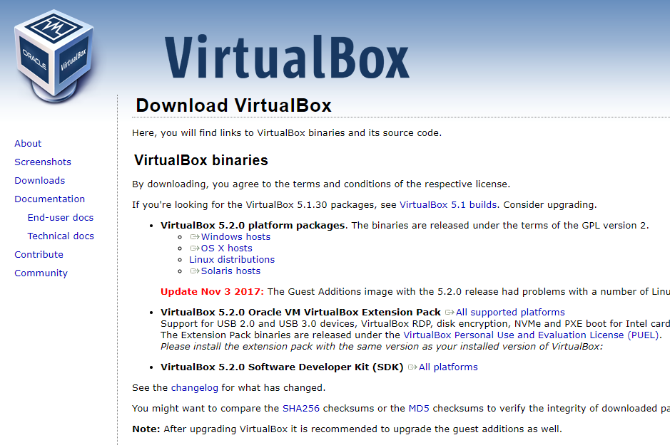
Installing the Simplescalar Environment (for Windows Users)
Download VirtualBox
‘https://www.virtualbox.org/wiki/Downloads’
Click!

Slide 5
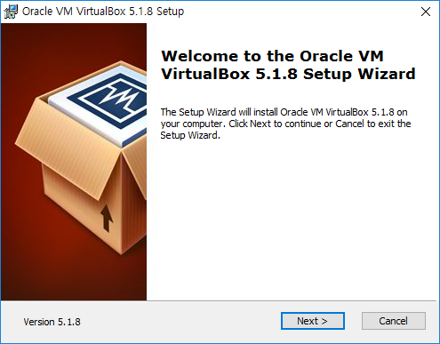
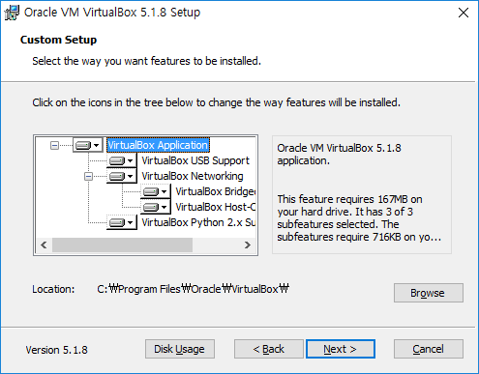
Installing the Simplescalar Environment (for Windows Users)
Install VirtualBox
Click!
Click!

Slide 6
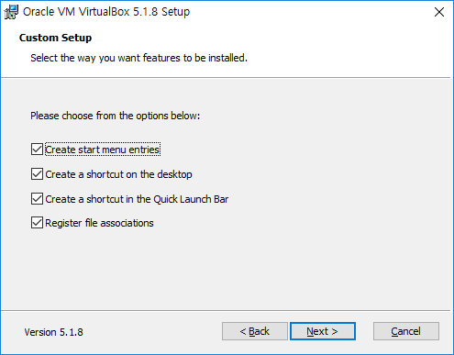
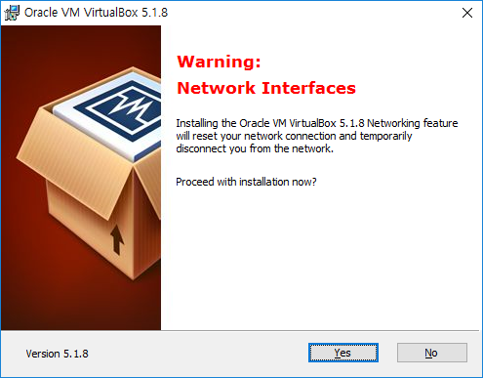
Installing the Simplescalar Environment (for Windows Users)
Install VirtualBox
Click!
Click!

Slide 7
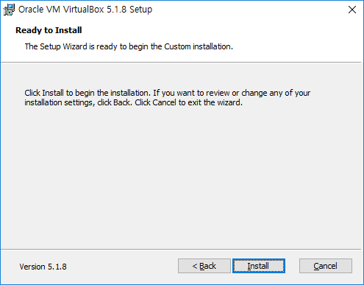
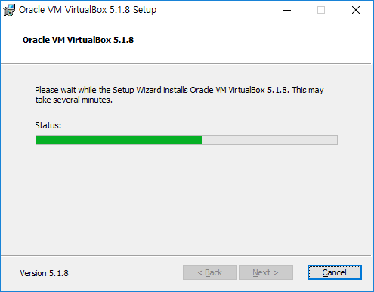
Installing the Simplescalar Environment (for Windows Users)
Install VirtualBox
Waiting!
Click!

Slide 8
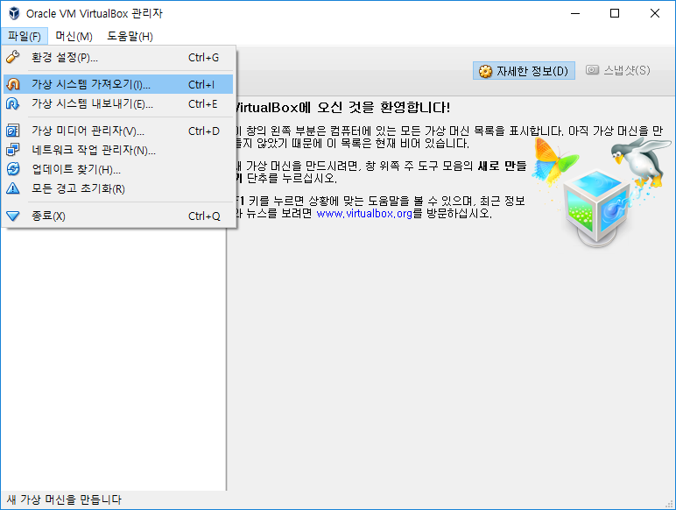
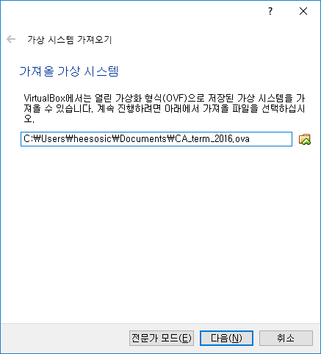
Installing the Simplescalar Environment (for Windows Users)
Import virtual system
“https://drive.google.com/file/d/1d7mInXydX6gFwDSyaFbHYNeyp-XtlVJ_/view?usp=sharing”
Click!
Click!

Slide 9
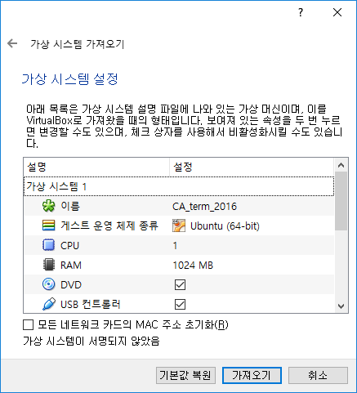
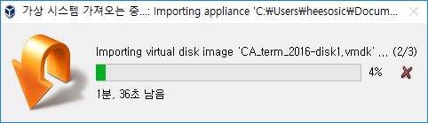
Installing the Simplescalar Environment (for Windows Users)
Import virtual system
Waiting!
Click!

Slide 10
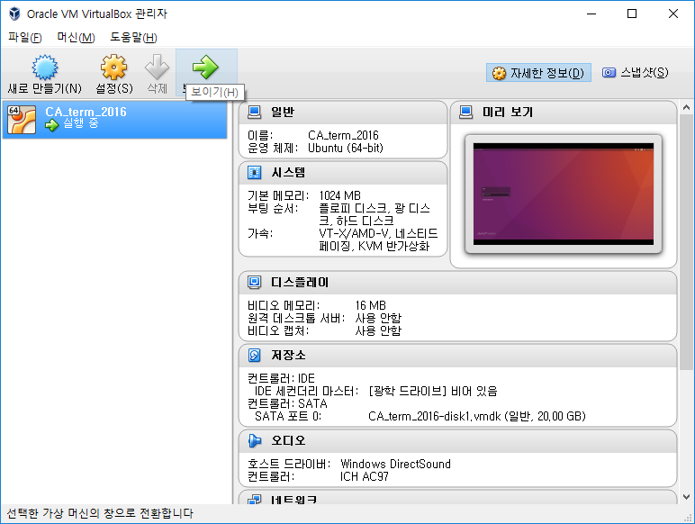
Installing the Simplescalar Environment (for Windows Users)
Import virtual system
Click!
pw:1234

Slide 11
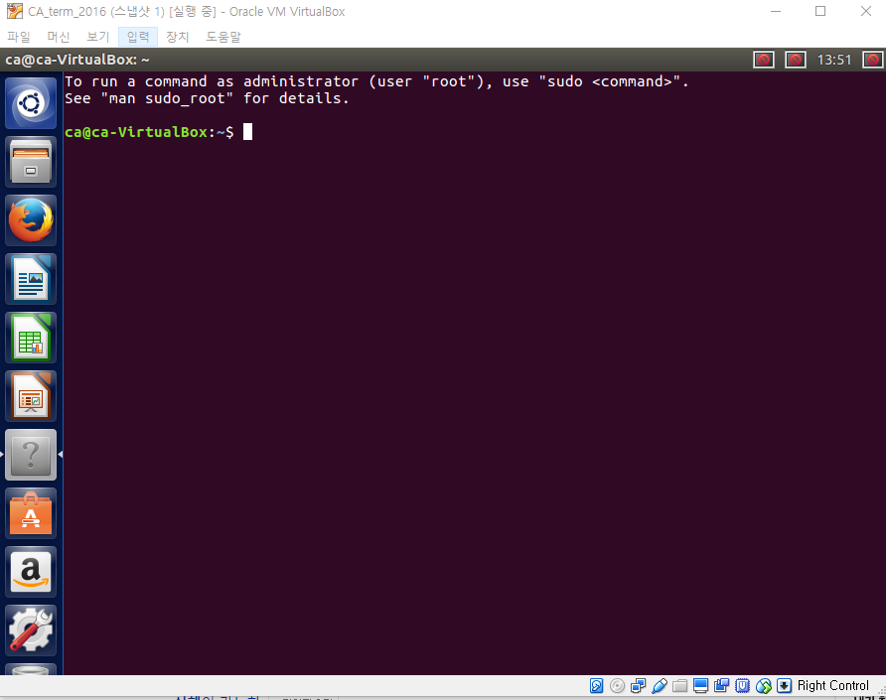
Installing the Simplescalar Environment (for Windows Users)
Practice Simplescalar
1. Execute a terminal
2. Enter the directory of Simplescalar
‘cd simplesim-3.0/’
3. Execute benchmarks using Simplescalar (cc1, go)
./sim-outorder benchmark/apsi00.peak.ev6 < benchmark/apsi.in
./sim-outorder -max:inst 100000000 benchmark/mcf benchmark/inp.in

Slide 12
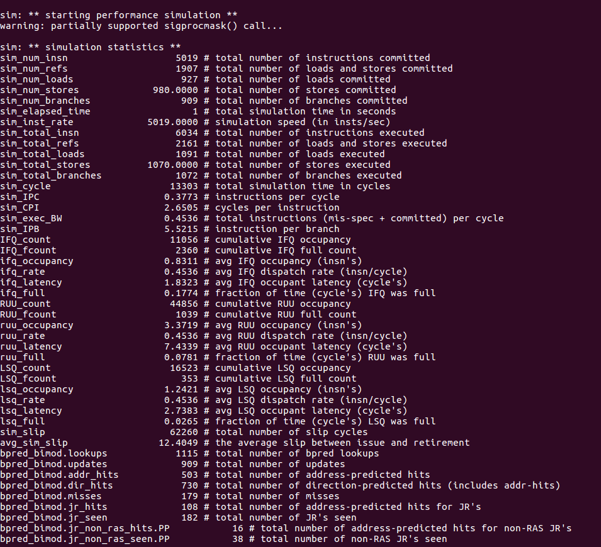
Installing the Simplescalar Environment (for Windows Users)
Practice Simplescalar
You can see simulation statistics
total number of instructions
total number of loads and stores
total number of branches
total simulation time in cycles
etc..
You have to analyze and modify the source code of cache replacement policy in Simplescalar
‘vi cache.c’
‘vi cache.h’
After you modify the source code, you have to re-compile the Simplescalar
‘make’

Slide 13
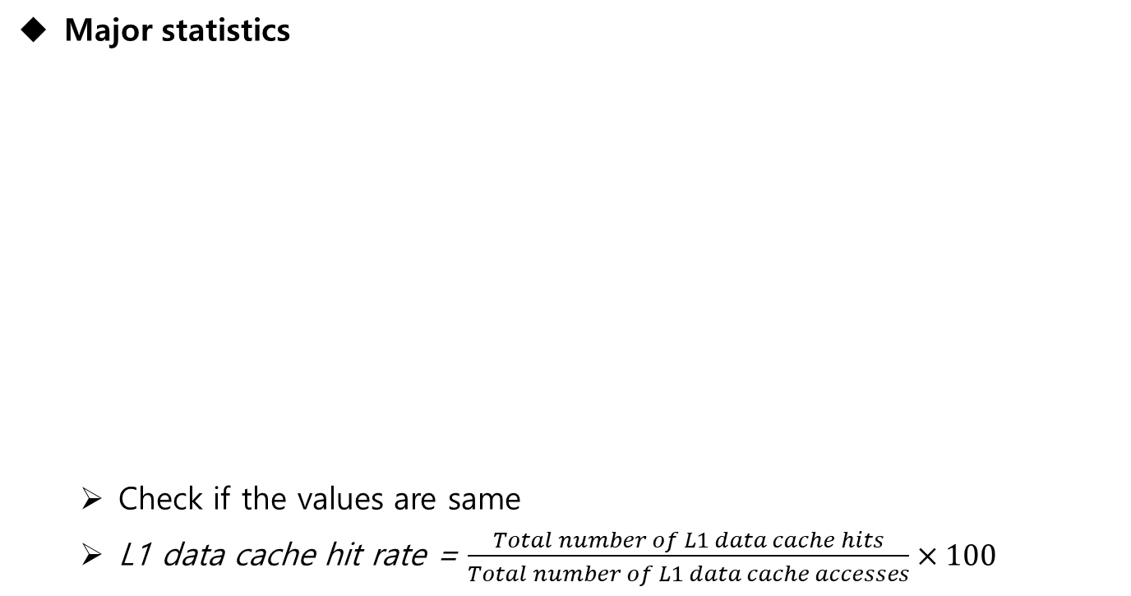
Installing the Simplescalar Environment (for Windows Users)
Major statistics
Check if the values are same
L1 data cache hit rate = $\frac{Total number of L1 data cache hits}{Total number of L1 data cache accesses}×100$
Benchmark | Total # of instructions (sim_num_insn) | # of Data L1 cache accesses (dl1.accesses) | # of Data L2 cache accesses (ul2.accesses) | CPI (sim_CPI)
apsi | 50190686 | 25069771 | 12511049 | 0.3767
mcf | 100000000 | 82136338 | 14285308 | 0.4645
Benchmark results
*default cache replacement policy - LRU (Least Recently Used)

Slide 14
Q&A

